Slide 1

Censorship Resistance: Decoy Routing
Content may be borrowed from other resources.
See the last slide for acknowledgements!
Amir Houmansadr
CS660: Advanced Information Assurance
Spring 2015

Slide 2
Classes of Information Hiding
Digital watermarking
Steganography
Covert channels
Anonymous communications
Protocol obfuscation

Slide 3










Traditional circumvention
X
IP Filtering
DNS Hijacking
DPI
X
Gateway
User’s AS
Blocked
Insider attaacks
Network identifiers
DPI
Active probes
Proxy
The Non-Democratic
Republic of
Repressistan

Slide 4
Decoy routing circumvention
An alternative approach for circumvention
It builds circumvention into network infrastructure
DR (Karlin et al., FOCI 2011)
Cirripede (Houmansadr et al., ACM CCS 2011)
Telex (Wustrow et al., USENIX Security 2011)

Slide 5
Some background

Slide 6
Internet topology 101
The Internet is composed of Autonomous Systems (ASes)
An Autonomous System is a network operated by a single organization
44,000 ASes are inter-connected based on their business relationships

Slide 7
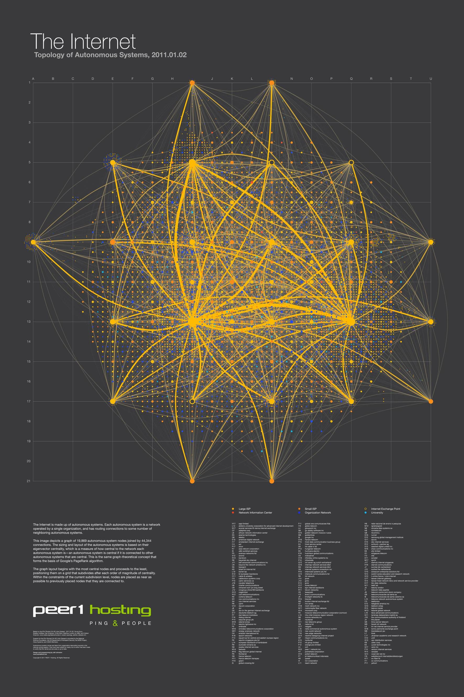

The Internet map of ASes

Slide 8


Routing in the Internet
Transit AS
Transit AS
User’s AS
CNN’s AS

Slide 9

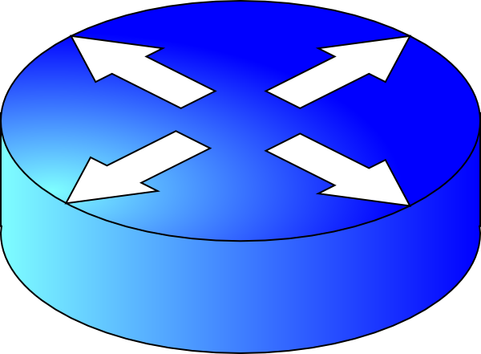
Decoy Routing Circumvention
Decoy AS
Non-blocked
X
Gateway
User’s AS
Blocked
Proxy
The Non-Democratic
Republic of
Repressistan

Slide 10
Cirripede

Slide 11





Threat model
Warden ISP
Monitor traffic
Block arbitrarily
Constraint: Do not degrade the usability of the Internet
TLS is open
Warden ISP
Client (C)
Notes:
A monitoring/blocking entity (censor) monitors all of the Internet traffic of its users
The censor can block any traffic, subject to keeping the usability of the Internet for its users
(sensor can do IP blocking or DPI)
that the warden is only willing to perform selective blocking and is unwilling to block Internet access entirely, use a small “white list” of allowed sites, or block all HTTPS (port 443) traffic.
Internet shutdown in Egypt, Jan 2011. lasted only one week
Censor is willing to block certain web sites and services (even popular ones) if it learns that they are being used to circumvent blocking.
No active tampering of traffic by censor.

Slide 12


Overt Destination (OD)
Covert Destination (CD)
C
Main idea
Notes:
High level of the system

Slide 13


Registration Server (RS)
Deflecting Router
(DR)
Cirripede’s
Service Proxy
Good ISP
C
Cirripede Architecture
Notes:
No shared secret/design element
A Public key,
Cirripede’s elements:
Registration server (RS)
Service Proxy (SP)
Collaborating ISP
Deflecting router, with deflection table

Slide 14
Registration Server (RS)
OD
OD
Client IP
OD
Good ISP
Uses TCP ISN steganography
discussed earlier
C
Client Registration
Notes:
Say “covert channel”

Slide 15
Registration
Client (C)
Collaborating DR
Cirripede’s RS
Notes:
Our PRNG: AES-128 cipher in counter mode
DH: curve25519 elleptic curve DH
P=2^255-19, so each element of the group is 255-bits
It makes all the items uniformly distributed
We send 255 bit of K_C + 33-bit of tag = total 36 bytes/24 -> 12 TCP sessions
ISN is used to remove confusion about multiple TCP sessions between two endpoints.
ISN is chosen randomly, and should be hard to guess by other entities to prevent IP spoofing (??right?)
We use the twist of the elliptic curve as well.

Slide 16
RS
OD
Client IP
Cirripede’s
Service Proxy
CD
C
Covert communication
Notes:
Traffic deflection
If they are connected use policy-based routing
Ip-in-ip, or we could use GRE

Slide 17
Routing Around Decoys
Schuchard et al., ACM CCS 2012

Slide 18
Routing Around Decoys (RAD)
Blocked
Non-blocked
Decoy AS
Gateway
The Non-Democratic
Republic of
Repressistan
Notes:
The basis of the RAD attack is the observation that ISPs in the censorship region are likely to have multiple paths to any given destination. Therefore, censors can instruct the ISPs under their influence to exclusively select routes that do not pass through the ISPs known to deploy decoy routers.

Slide 19
The Costs of Routing Around Decoys
Houmansadr et al., NDSS 2014

Slide 20
This paper
Concrete analysis based on real inter-domain routing data
As opposed to relying on the AS graph only
While technically feasible, RAD imposes significant costs to censors

Slide 21
Main intuition: Internet paths are not equal!
Standard decision making in BGP aims to maximize QoS and minimize costs

Slide 22
Degraded
Internet reachability
Blocked
Non-blocked
Decoy AS
Gateway
Decoy AS
The Non-Democratic
Republic of
Repressistan

Slide 23
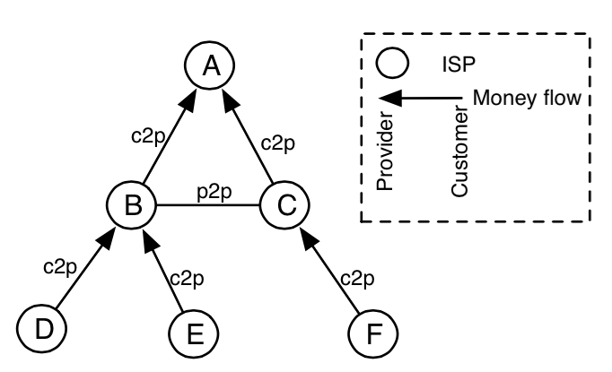
Path preference in BGP
ASes are inter-connected based on business relationships
Customer-to-provider
Peer-to-peer
Sibling-to-sibling
Standard path preference:
Customer
Peer/Sibling
Provider

Slide 24
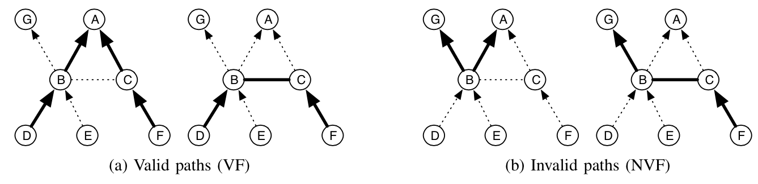
Valley-free routing
A valley-free Internet path:
each transit AS is paid by at least one neighbor AS in the path
ISPs widely practice valley-free routing
Notes:
Edges are not equal, in realy as graph satisfies gao’s. for business reasons ISPs strongly prefers through …

Slide 25

2. Non-valley-free routes
Blocked
Provider
Non-blocked
Decoy AS
Gateway
Customer
Provider
The Non-Democratic
Republic of
Repressistan
Notes:
if a Chinese AS does not have a decoy- free path to a certain destination, it can re-route traffic to that destination through one of the other 198 ASes in China, e.g., a customer AS or an AS with which it has no business relationship. This is a key factor in the success of the RAD attack, because it increases the number of alternative paths available to the RAD ASes. MPLS VPN

Slide 26
3. More expensive paths
Blocked
Customer
Non-blocked
Decoy AS
Gateway
Provider
The Non-Democratic
Republic of
Repressistan
Notes:
Dollar sign

Slide 27
4. Longer paths
Blocked
Non-blocked
Decoy AS
Gateway
The Non-Democratic
Republic of
Repressistan
Notes:
susceptible to higher network latencies, lower throughputs, and more frequent network failures

Slide 28

5. Higher path latencies
Blocked
Non-blocked
Decoy AS
Gateway
The Non-Democratic
Republic of
Repressistan
Notes:
Longer routes are not the only cause of higher latencies. The alternative paths selected by RBGP are likely to pass through less popular transit ASes that offer lower capacity, causing packets to experience higher latencies. This is confirmed by our simulations in Section VII, which show that, even when an RBGP path has the same length as the corresponding BGP path, it usually has higher latency.

Slide 29
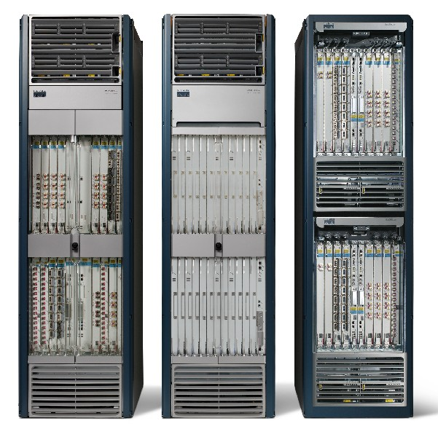
6. New transit ASes
Blocked
Non-blocked
Decoy AS
Gateway
Edge AS
The Non-Democratic
Republic of
Repressistan
Notes:
Show picture of routers

Slide 30
7. Massive changes in transit load
Loses transit traffic
Blocked
Transit AS
Non-blocked
Decoy AS
Gateway
Transit AS
The Non-Democratic
Republic of
Repressistan
Over-loads

Slide 31
Simulations
Use CBGP simulator for BGP
Python wrapper
Datasets:
Geographic location (GeoLite dataset)
AS relations (CAIDA’s inferred AS relations)
AS ranking (CAIDA’s AS rank dataset)
Latency (iPlane’s Inter-PoP links dataset)
Network origin (iPlane’s Origin AS mapping dataset)
Analyze RAD for
Various placement strategies
Various placement percentages
Various target/deploying Internet regions

Slide 32
Costs for the Great Firewall of China
A 2% random decoy placement disconnects China from 4% of the Internet
Additionally:
16% of routes become more expensive
39% of Internet routes become longer
Latency increases by a factor of 8
The number of transit ASes increases by 150%
Transit loads change drastically (one AS increases by a factor of 2800, the other decreases by 32%)
Notes:
Random-no-ring-1
4% NVF

Slide 33
Strategic placement
RAD considers random selection for decoy ASes
This mostly selects edge ASes
Decoys should be deployed in transit ASes instead
For better unobservability
For better resistance to blocking
86% are edge ASes

Slide 34
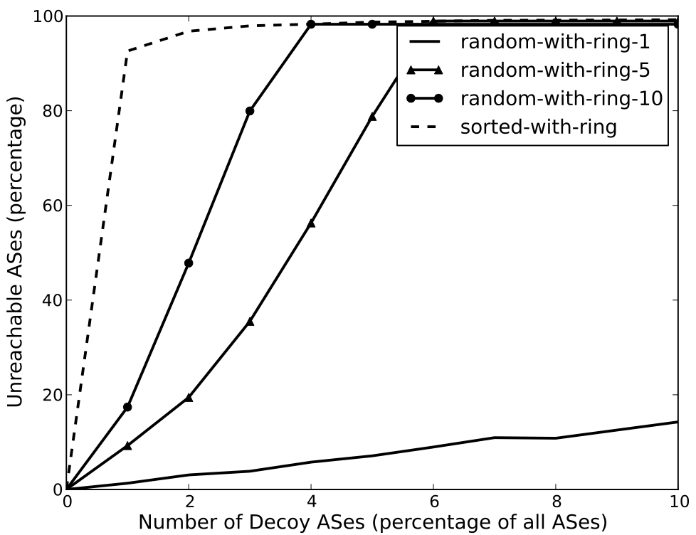
Strategic placement
20% unreachability
43% unreachability
4% unreachability

Slide 35
Lessons
RAD is prohibitively costly to the censors
Monetary costs, as well as collateral damage
Strategic placement of decoys significantly increases the costs to the censors
The RAD attack is more costly to less-connected state-level censors
Even a regional placement is effective
Analysis of inter-domain routing requires a fine-grained data-driven approach
Notes:
Business problem, not a graph problem.
Analysis based solely on the graph topology of the Internet may lead to mistaken conclusions about the feasibility of decoy routing

Slide 36
Acknowledgement
Some pictures are obtained through Google search without being referenced

